Slide 1
Racing Toward Effective Communication Tools
Notes:
TELL: Place Holder

Slide 2
Workplace Communication
To be effective in the workplace it is important that you become skilled at the communication process.
We spend up to 80% of our workday communicating.
Sharing recipes
Asking questions/Providing answers
Warnings (Hot pan coming through!)
Talking with customers (students, parents, principals)
Writing down production numbers
Notes:
TELL:
This training focuses on the importance of developing your personal communication skills . Clear communication is essential in every aspect of our job, whether we are training , coaching or evaluating our employees we need to be clear about our expectations. Honest clear communication is one of the most important key ingredients in managing people and implementing new policies and procedures.

Slide 3
What Is Communication?
Communication is a process of transferring information from one person to another using mutually understood signs, symbols, and speech rules.
Communication only works if all parties involved can find a common communication channel.
Notes:
TELL: For today’s class, we will use the following definition: Communication is a process of transferring information from one person to another. It is commonly defined as, "the imparting or interchange of thoughts, opinions or information by speech, writing or signs.”
Instructor:
Respond based upon what students replied (use language i.e. those were perfect examples or we just heard a great example of what communication is.)

Slide 4
Accomplishing
effective communication:
Speaking to Listening
Sending to Receiving
Writing to Reading
Notes:
TELL:

Slide 5
Comfort in Communication
Effective communication involves both speaking and listening. This builds trusts between you and the employee.
Make the person feel comfortable enough to attempt to learn and be open to communicate with you.

Slide 6
Miscommunication In The
Workplace
Communication between employees plays a major role in boosting workplace productivity and building trust.
Maintaining good communication can be challenging but not impossible when workers speak different languages.

Slide 7
Be Patient and Respectful
Both parties need to be patient and understanding, without being offensive.
Listen without interrupting and ask questions at the end. Respect and patience go hand in hand.
Notes:
Being aware of your own body language and what it conveys helps communicate effectively with non-English speakers.
Pay close attention to the facial expressions used by those whom you're speaking to. It can give clues about whether your message is getting across.

Slide 8
Passing the Baton in Communication
Be inclusive with the employee, not discriminative.
Practice skills to communicate better. Balance expressing yourself and giving space for others to share their thoughts and feelings.
Include your team in these communication strategies to build trust and foster a positive working environment.

Slide 9
Jumping the Hurdle
When would communication be imperative in your Food Service operation?

Slide 10
Food Service Industry
We use various verbal communication channels in our food service industry.
Production
Customer Service
Safety Precautions

Slide 11
Types of Communication
There are multiple ways to communicate a message:
Verbal
Visual
Written
Non-Verbal
Notes:
TELL: There are different types of communication or ways in which to transfer information or impart thoughts or opinions in a clear and concise manner, it is sometimes best to utilize more than one type of communication. You may not realize that communication is more than talking to others.

Slide 12
Verbal Communication
Verbal communications are messages and information sent through spoken words.
In-person conversations, phone calls, Zoom, FaceTime
Notes:
TELL: There are different types of communication or ways in which to transfer information or impart thoughts or opinions in a clear and concise manner, it is sometimes best to utilize more than one type of communication. You may not realize that communication is more than talking to others.

Slide 13
Visual Communication
Visual communications are messages sent in forms that are seen.
Video, instructions, signs, banners, commercials or LAUSD trainings
Notes:
TELL: There are different types of communication or ways in which to transfer information or impart thoughts or opinions in a clear and concise manner, it is sometimes best to utilize more than one type of communication. You may not realize that communication is more than talking to others.

Slide 14
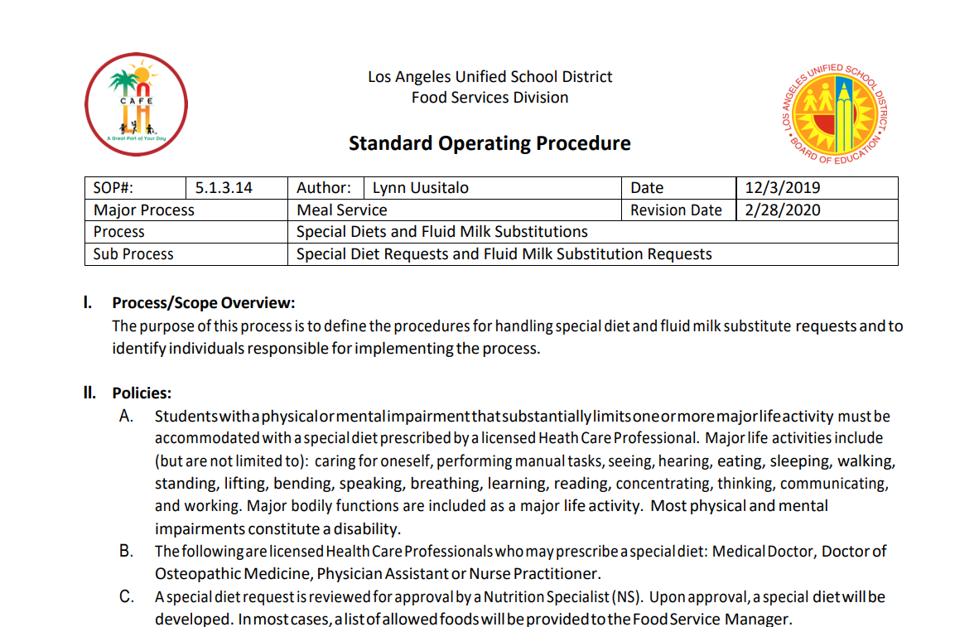
Written Communication
Written communications are messages, ideas and instructions in writing.
Letters, e-mail, SOP’s, recipes, policies and procedures
Notes:
TELL: There are different types of communication or ways in which to transfer information or impart thoughts or opinions in a clear and concise manner, it is sometimes best to utilize more than one type of communication. You may not realize that communication is more than talking to others.

Slide 15
Communication Awareness
Did You Know?
Spoken and written words make up only 15% of our communication!
We are constantly communicating with those around us without thinking about it. Every time we smile, make eye contact, cross our arms, or roll our eyes, we are communicating with others.

Slide 16
Nonverbal Communication
Nonverbal communication is sending messages using parts of the body instead of the voice.
Eye contact is looking someone in the eye as they speak to you
Expressions include; smiling, frowning, raised eyebrows
Body Language can be movements like; arms crossed, head down, slouching, back turned and Gestures like thumbs up, waving, and hand signals.

Slide 18
Pay Attention To Body Language
Body language communicates beyond words. Maintain a positive demeanor and avoid demonstrating frustration such as; clenched fists, eye rolls, and frowning.
Body language can also show; openness, acceptance, frustration, and confusion.
Chances are, they feel the same way and will emulate those actions!
Notes:
Being aware of your own body language and what it conveys helps communicate effectively with non-English speakers.
Pay close attention to the facial expressions used by those whom you're speaking to. It can give clues about whether your message is getting across.

Slide 19
Comfort Zone Distancing
Friend Zone – 0.5 to 4 ft
Social Zone – 4 to 12 ft
Notes:
TELL: Non-verbal communication, commonly known as “body language.” Examples of body language are Eye Contact, Expressions, Gestures, Posture and body orientation and Location or Proximity.
TELL: In an effort to help you understand the impact that non-verbal communication cues can have, I will demonstrate some examples of the non-verbal cues.
Conduct Exercise: Body Language
INSTRUCTOR: Choose an individual in the front row whose name you know or ask them their name in order to carry out the exercises. Thank the individual for volunteering.
1.“Avoid looking into someone’s eyes and say to them “You did a really good job today.”
ASK- Which non-verbal cue is this an example of?
Acknowledge their answers. TELL: When you are speaking to someone and not using eye contact, you are not acknowledging him or her. Doing so leads the listener to be confused as to whom you are speaking.
INSTRUCTOR:
2. “Cross your arms in from of your body and say “I am open to any of your suggestions” – ASK: Which non-verbal cue is this example of? Acknowledge their answers.
TELL: when your arms are crossed, your are perceived as not being open-minded, conflicting with your statement of being open to suggestions.
INSTRUCTOR:
3. “Using your fingers put the shape of an L on your forehead”
ASK- Which non-verbal cue is this an example of? Acknowledge their answers.
TELL: Often you express yourself with gestures without thinking. However, the meaning of gestures can be very different, so it is important to be careful to avoid misinterpretation.
Instructor:
4. “Lean on the desk placing your face about 12 inches from their face and say, “Will you be meeting your deadline today”? -
ASK- Which non-verbal cue is this an example of? Acknowledge their answers. TELL: If I am leaning into you to say something private, it could be perceived negative. However, if I lean into your personal space to say something not private, it can be perceived as an uncomfortable negative experience.
Instructor:
5. “Roll your eyes and say to them “OK, let’s go over this one more time.”
ASK- Which non-verbal cue is this an example of? Acknowledge their answers.
TELL: This type of facial expressions demonstrates annoyance
TELL: Exhibiting what you have seen this can be a roadblock.

Slide 20
Jumping the Hurdle
How do you maintain positive body language?

Slide 21
Approaching Communication Challenges
When encountering communication challenges remember to:
Identify the issue
Hold your composure
Show compassion and tact
Facilitate a positive outcome
Notes:
A diverse workplace has many benefits but can have a few challenges.
Understanding how to identify and address cultural differences allows you to facilitate productive communication and cultivate a positive and accepting environment of people from all cultures.

Slide 22
Speak Slowly and Clearly
There’s more of a chance of you being understood if you speak slowly and clearly. However, do not speak so slowly as to appear condescending.
Notes:
Being aware of your own body language and what it conveys helps communicate effectively with non-English speakers.
Pay close attention to the facial expressions used by those whom you're speaking to. It can give clues about whether your message is getting across.

Slide 23
Keep It Simple
Don’t go into too much detail. Keep the message simple and to the point. The more complex the instructions, the harder it is to understand.
Notes:
Being aware of your own body language and what it conveys helps communicate effectively with non-English speakers.
Pay close attention to the facial expressions used by those whom you're speaking to. It can give clues about whether your message is getting across.

Slide 24
But not Too simple
Keep It Simple
“Go to the refrigerator, don’t bring the apples, bring 1 case oranges.”
“Pan 300 bean and cheese burritos for breakfast tomorrow ”
“Pan all the burritos for Breakfast tomorrow.”
“Get 1 box of oranges”
Notes:
Being aware of your own body language and what it conveys helps communicate effectively with non-English speakers.
Pay close attention to the facial expressions used by those whom you're speaking to. It can give clues about whether your message is getting across.

Slide 25
Make Eye Contact
Eye contact during a conversation shows multiple things. It can show attentiveness, interest, and engagement or the complete opposite, such as confusion or carelessness.
Notes:
Being aware of your own body language and what it conveys helps communicate effectively with non-English speakers.
Pay close attention to the facial expressions used by those whom you're speaking to. It can give clues about whether your message is getting across.

Slide 26
Visual Learners
Did you know visuals are processed 60,000 times faster than written content?
When words fail us, visuals can go a long way in explaining a concept.
10% Hearing
70% Seeing
20% Reading

Slide 27
Find Common Ground
Mathematics is the same all over the world and acts as a universal language.
Math helps people learn and communicate, even if other barriers exist.

Slide 28
Jumping the Hurdle
When is a good time to use math to communicate?

Slide 29
Comprehension Is Key
No matter which communication channels we use, our biggest obstacle is the ability (or inability) to understand what others are saying.
Every conversation, directive, and email will be unproductive if the words do not make sense to others.
There is no clear agreement amongst the team on what to do, nor how to do it.

Slide 30
Staying positive
Have a positive mindset when dealing with communication challenges.​
Change your perspective, and focus on the solution, rather than the problem.

Slide 31
Jumping the Hurdle
How do you keep a positive mindset when dealing with communication issues?

Slide 32
Self - Improvement
Set goals for:
Listening better
Communicating clear messages
Becoming aware of nonverbal cues
Notes:
ASK: How can you continue to improve your communication skills?
INSTRUCTOR: Solicit responses and provide praise for their commitments to improve upon their communication skills.
TELL: Create an action plan and set goals for: listening better, communicating clear messages and becoming aware of non-verbal cues. How does a musician make it to Carnegie Hall? With practice! As they say, practice makes perfect.

Slide 33
If we’re honest with ourselves, we could all improve!

